Slide 1

ACT & SAT participation rates by state
DSI-20 Project 1
Daphne Kwok

Slide 2
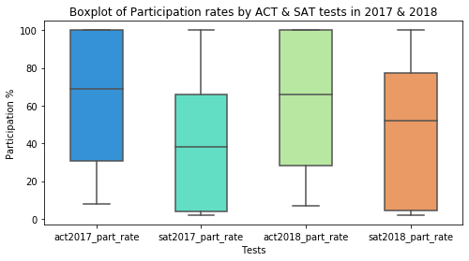
SAT participation improvement Plan
Analyze statewide participations after the new SAT format was released in March 2016.
SAT participation is lower than ACT for 2017 & 2018
Recommendations to improve SAT participation rates

Slide 3
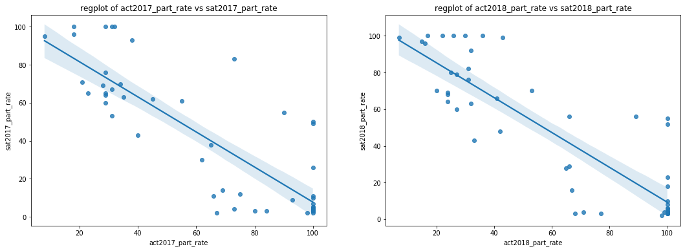
Inverse relationship between SAT & ACT participations
High SAT participation rate have low ACT participation rate and vice versa.
States like Delaware high SAT participation as they conduct free SAT state-wide testing and the alternative ACT will be taken voluntarily by students

Slide 4
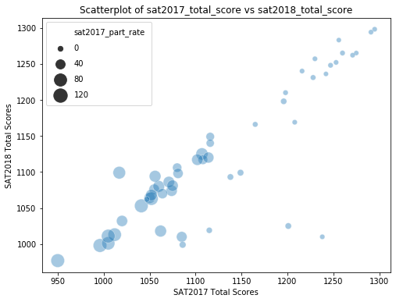
Low SAT Participation but High SAT Scores
Size of datapoints indicates SAT 2017 Participation rates.
The larger the size, the greater SAT 2017 Participation
States with low SAT 2017 Participation produced higher SAT Scores in 2017 and 2018 compared to States with higher Participation
Scores did not change much in 2017 & 2018 for each states as a whole
Continue in the next slide

Slide 5
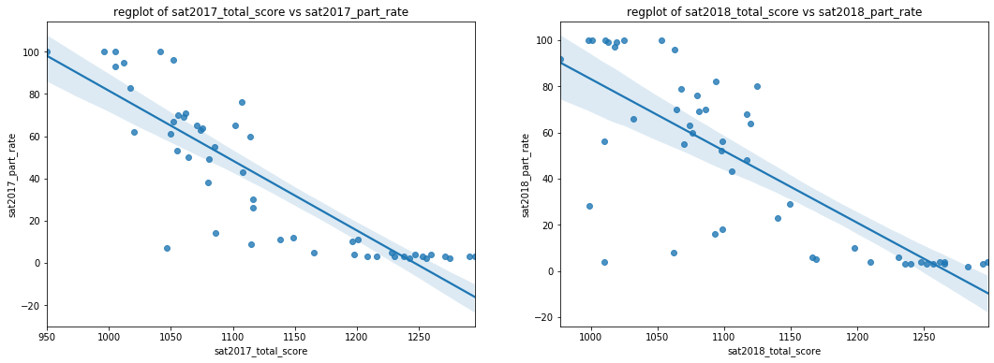
Low SAT Participation but High SAT Scores
Students from states with low SAT Participation rates voluntarily sign up and pay to take their SAT tests since there is no free state-wide testing.
One possibility that they tend to score better is because they studied for the test and taking an additional SAT test can improve their college applications.
Notes:
Minnesota and Wisconsin have 100% participation rate in ACT 2017 & ACT 2018 but have the lowest participation rate in SAT 2017 & SAT 2018.But the average Total SAT scores in 2017 & 2018 are the highest in USA
Delaware has 100% participation rate in SAT 2017 & SAT 2018 but have the lowest participation rate in ACT 2017 & ACT 2018. But the average Total SAT scores in 2017 & 2018 are the lowest in USA.
Connecticut has 100% participation rate in SAT 2017 & 2018. Connecticut has the lowest participation rate in ACT 2017 & ACT 2018 but produced one of the highest scores for ACT 2017 & 2018.

Slide 6
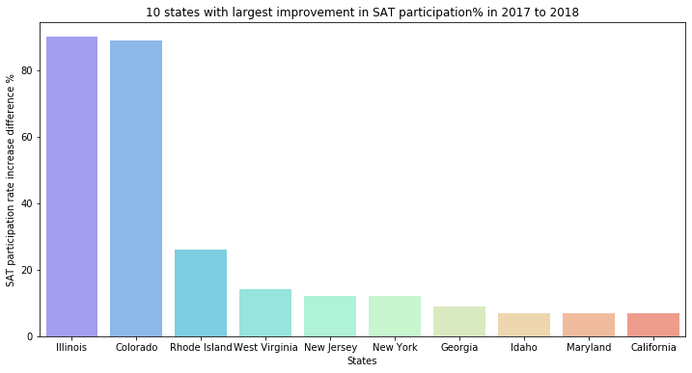
Top 10 States with improvement in SAT Participations
Illinois and Colorado has more than 80% increase in SAT Participation rate!

Slide 7
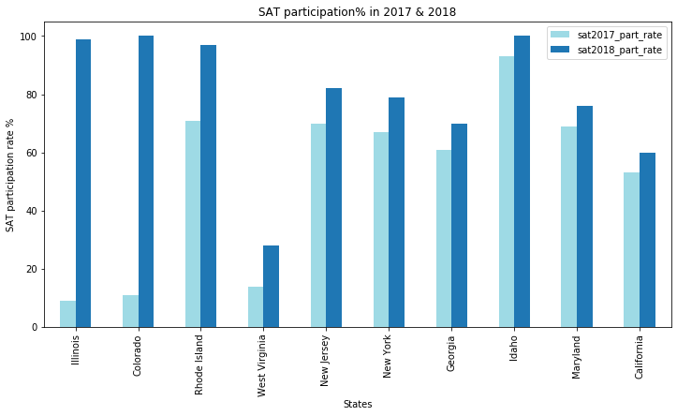
Top 10 States with 100% SAT participation due to State wide testing
Illinois and Colorado made SAT mandatory in their states in 2018
Hence this explains the increase in SAT participation rates to 100%

Slide 8
Recommendations
Encourage states to make SAT a statewide testing requirement.
SAT is a compulsory requirement and is free
Participation rates will increase.
2. Promote SAT School Day even if the state is not mandated to test SAT.
Convenient for students to take the test in school on a weekday
Provides free tests to low-income students
3. Market SAT as an additional test for students increase their competitiveness in college applications

